Slide 1
July 22nd Update

Slide 2
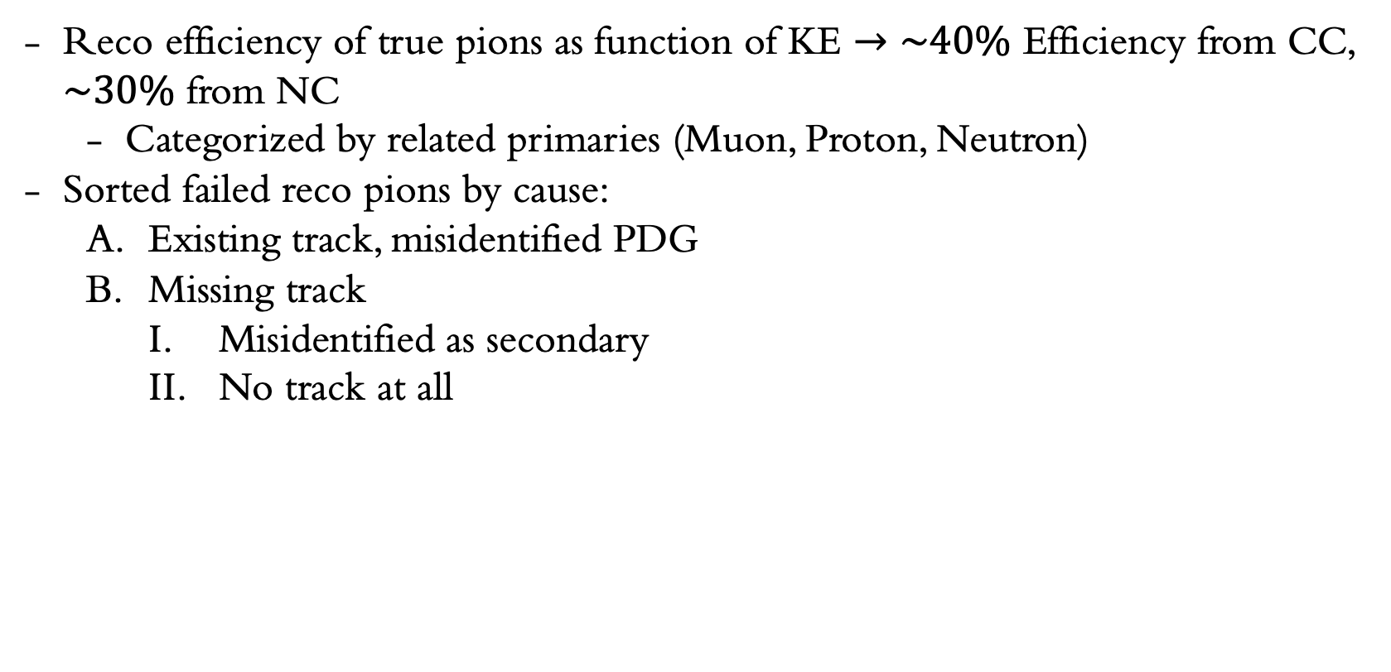
Recap:
Reco efficiency of true pions as function of KE $→\sim 40\%$ Efficiency from CC, $\sim 30\%$ from NC
Categorized by related primaries (Muon, Proton, Neutron)
Sorted failed reco pions by cause:
Existing track, misidentified PDG
Missing track
Misidentified as secondary
No track at all

Slide 3
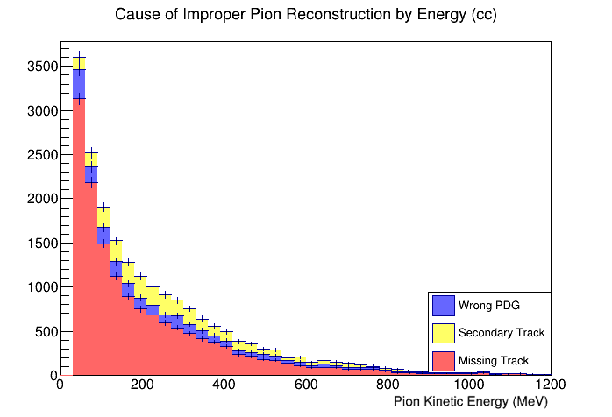
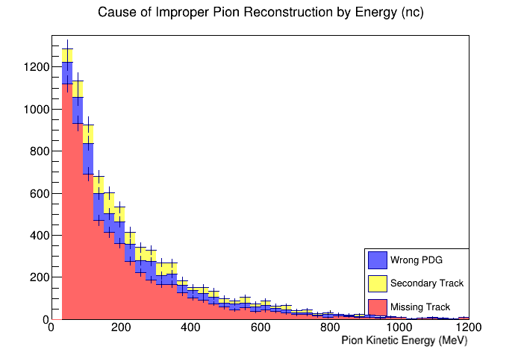
Recap:

Slide 4
Pion Histories
Non-contained
(trueSimPartContained == 0)
Range out
(momentum at end approx. 0, trueSimPartContained == 1)
Decay in flight
(has particles whose ancestor is this pion and trueSimPartProcess == 1)
Secondary interactions
(has particles whose ancestor is this pion and trueSimPartProcess == 2)

Slide 5
Pion Histories
Non-contained
(trueSimPartContained == 0)
Range out
(momentum at end approx. 0, trueSimPartContained == 1)
Decay in flight
(has particles whose ancestor is this pion and trueSimPartProcess == 1)
Secondary interactions
(has particles whose ancestor is this pion and trueSimPartProcess == 2)

Slide 6
Ntuple Maker
Reading/learning the mctrack and mcstep objects
Modify ntuple maker scripts to save Track.End.Px() from mctrack
Track end momentum variable for ranged out particles not exactly 0
Learning how to use the ntuple maker
Modifying submit_ntuple_job and run_ntuple_maker file
Currently working through errors related to job submission

Slide 7
Next Steps
Create ntuple files with new variables
Get plots of true pion histories, collinearity
Correlation between missing tracks and other colinear primaries?
Which pion history fails reconstruction most often?

